Slide 1

IMPACT OF MUSIC ON FOCUS & PERFORMANCE
Team 14
Arnav Sachdeva, Aryan Sehgal, Nimisha Agarwal, Rashi Jaiswal, Shrinidhi Bhide

Slide 2
INTRODUCTION
Soft jazz music creates a balance between engagement and ambiance, potentially influencing focus and productivity.
Our study explores its effects on task performance, mental engagement, and enjoyment.
Background

Slide 3
PROBLEM
Null Hypothesis
Does listening to jazz music impact task performance, concentration, and perceived enjoyment?
Listening to soft jazz music has no effect on task performance, concentration and perceived enjoyment
Research Question
Alternative Hypothesis
Listening to soft jazz music has an effect on task performance, concentration and perceived enjoyment

Slide 4
EXPERIMENT DESIGN
Participants
Procedure
Intervention
- 62 observations
- BU students
- Mathematical Task (Countdown)
- Spatial Task (Sorting Cards)
Piano Jazz Music while performing tasks
Randomization
Data Collection
Parameters
- Coin Toss
(Simple Randomization)
- In person
- Tasks and Questions
- Demographics
- Task Performance
- Subjective Experience
Methodology

Slide 5
PRE EXPERIMENT MEASURES
Demographics
Preferences
- Age
- Gender
- First Language
- Is a quiet environment important for you when working on tasks?
- How often do you listen to music while working?
Variables

Slide 6
POST EXPERIMENT MEASURES
Task Performance
Experience Measures
- How stressed did you feel while completing the tasks?
- How enjoyable did you find the tasks?
- How focused did you feel while completing the tasks?
- Accuracy Score for Task 1
- Accuracy Score for Task 2
- Time Taken for Task 1
- Time Taken for Task 2
Outcome Variables

Slide 7
ANALYSIS
Data Pre-Processing
ATE / CATE
T-Tests
Exploratory Data Analysis
Statistical Power
Regression with Covariates
Project Procedure

Slide 8
INSIGHTS

Slide 9
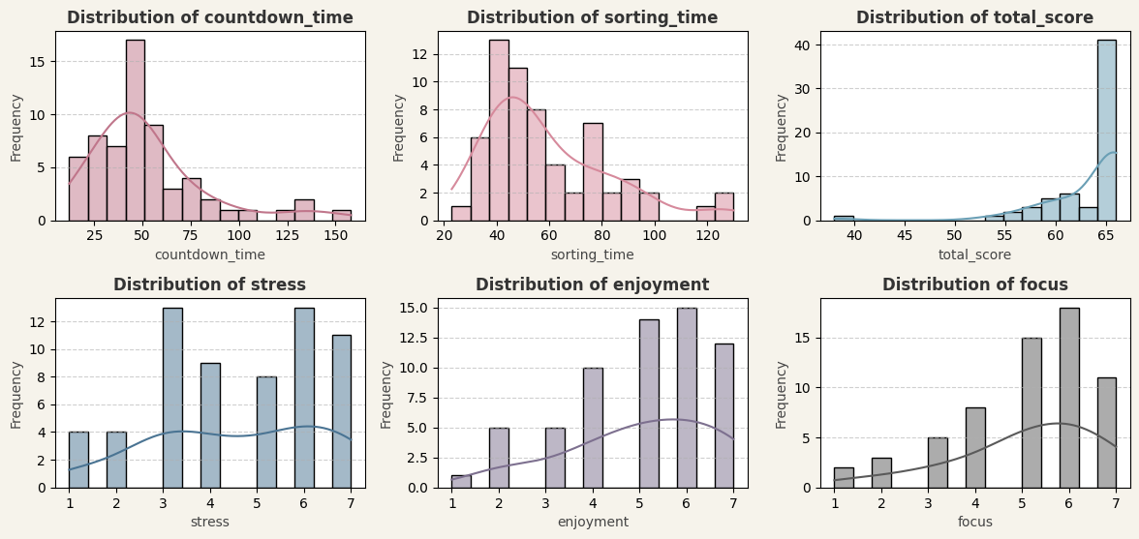
Outcome Distribution

Slide 10
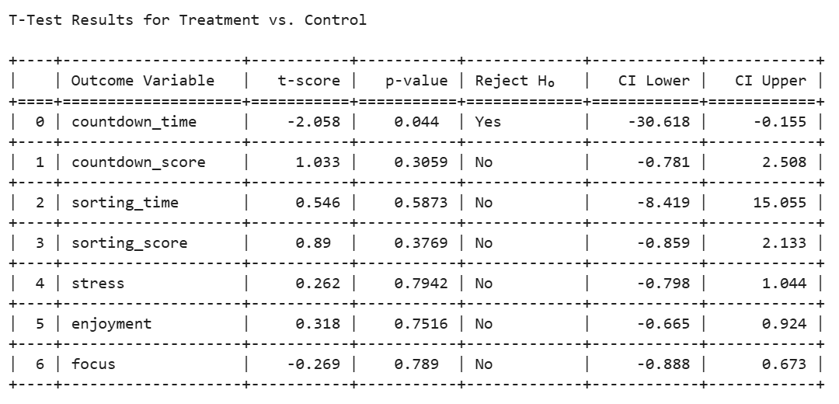
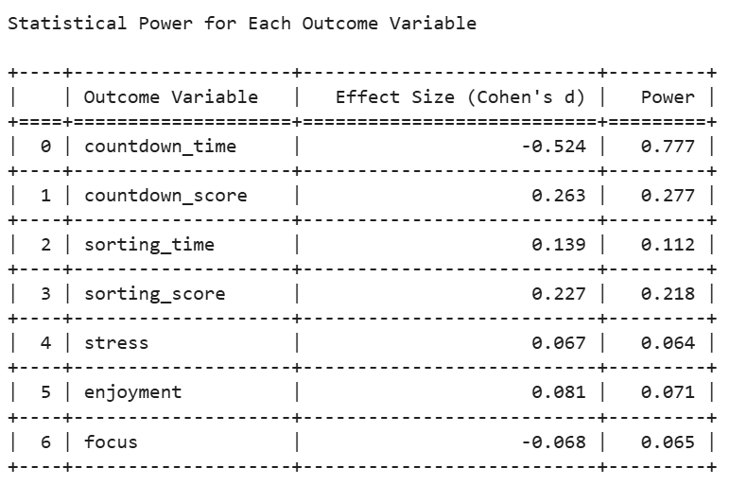
Significant
Significance & Power

Slide 11
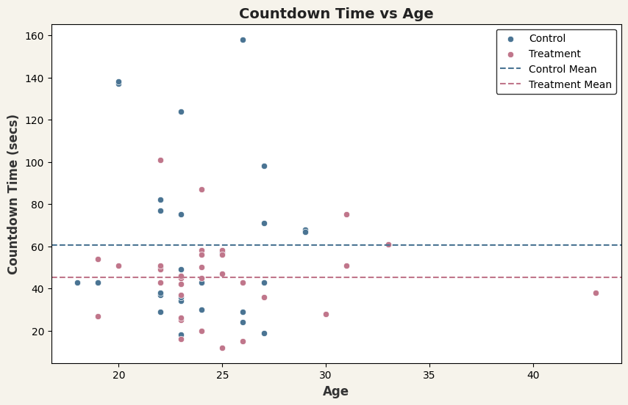
ATE
Larana University | 2024

Slide 12
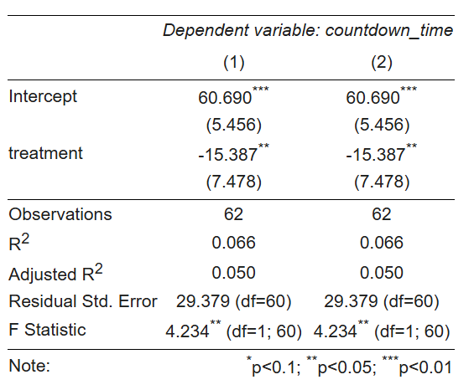
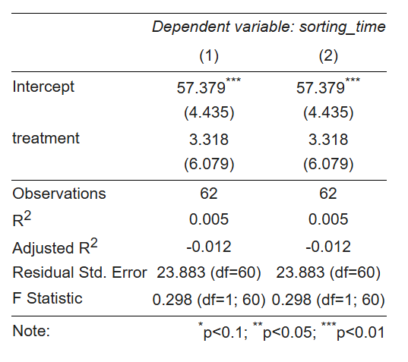
Treatment Group performed the countdown task faster (by 15.39 seconds)
Task Performance - Time

Slide 13
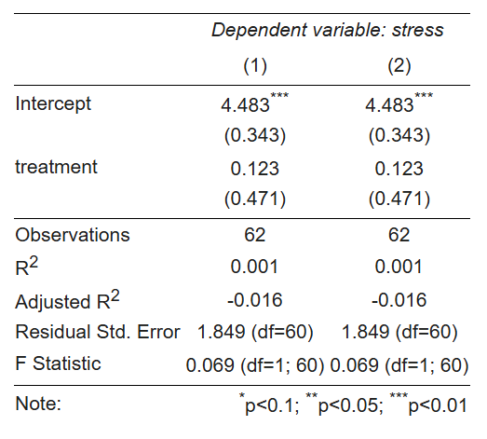
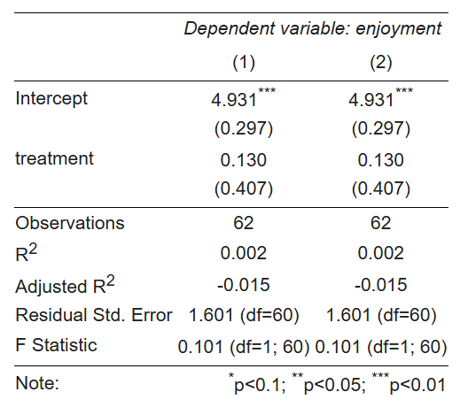
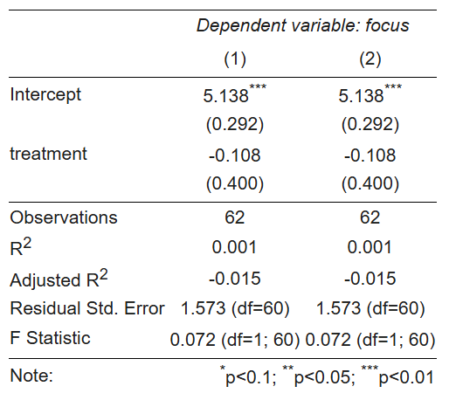
No significant difference in terms of other outcomes
Experience Measures

Slide 14
CONCLUSION

Slide 15
RECOMMENDATIONS
1
Provide an option to toggle music on/off in workplaces to accommodate different preferences
Practical Applications
2
Integrate custom jazz playlists and adaptive music features into apps like Notion and Pomodoro timers to enhance focus and engagement.
3
Establish designated silent areas alongside music-friendly spaces in educational environments for greater flexibility

Slide 16
LIMITATIONS
Small Sample Size
Control Setup
Challenges
Subjective Measures
Limited Task Types

Slide 17
FUTURE STEPS
Study Long-Term Effects
Test Different Music Styles
Add More Task Varieties
Further Exploration
Increase Sample Size

Slide 18
THANK YOU

